Slide 1



Tract-analysis and connectivity
Eleftherios Garyfallidis, PhD
Diffusion Imaging in Python
http://dipy.org
Sherbrooke Connectivity Imaging
Laboratory http://scil.dinf.usherbrooke.ca

Slide 2

Basic Principles
Streamlines are polylines (a series of line segments) where their points are in floating point coordinates (x=10.3, y=10.5, z=1.8).
These coordinates can be transformed to the image coordinates which are integer coordinates (i=10, j=11, k=2).
An affine transformation (4x4 transformation matrix) is needed to go from streamline coordinates to image coordinates. Given e.g. from the Nifti file.
Often interpolation is also needed. Usually trilinear or nearest.
Common file formats are Trackvis (*.trk) or *.vtk, *.tck etc.
Alert! Make sure you understand the space of the streamlines in comparison to the space of the images and how to go from the one space to the other.
Alert! Familiarize yourself with RAS 1mm, LPS etc.
Alert! Know your voxel origin. Is it in the center of the voxel (e.g. Nifti) or in the corner of the voxel (e.g. Trackvis).
Tract-analysis and connectivity - Eleftherios Garyfallidis (2015)

Slide 3
Basic Principles
TODO
Add figure of bundle and metric map showing the transformation from the one to the other.
Case 1 streamlines and metrics in the same space.
Case 2 streamlines and metrics in different space but still having the transformation from the one to the other.
By interpolating the metric values on the points of the streamlines you can address
Tract-analysis and connectivity - Eleftherios Garyfallidis (2015)

Slide 4
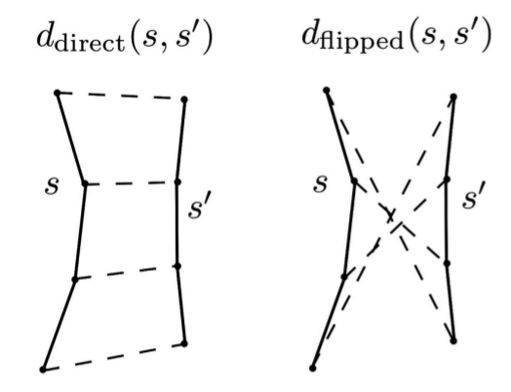
Streamline distances
Minimum Direct Flipped (MDF) distance
Garyfallidis et al., Frontiers 2012
min(ddirect, dflipped)
Fast to compute
Symmetric
Metric distance
Values from 0 to Inf
Interpolation along the length is necessary
with fixed number of points. Recommended numbers
are from 12 to 20.
Low MDF
Higher MDF
Tract-analysis and connectivity - Eleftherios Garyfallidis (2015)

Slide 5
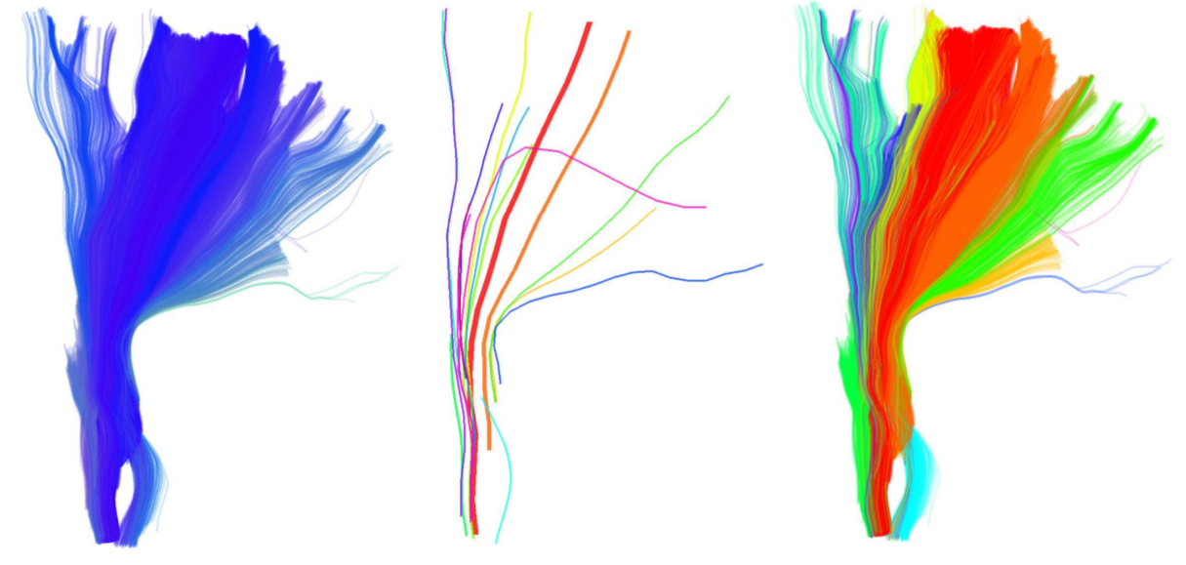
QuickBundles for Simplification
Using Minimum Direct Flipped (MDF) and
the QuickBundles clustering algorithm
Garyfallidis et al., Frontiers 2015
You will be able to identify hidden areas of
your datasets and simplify the computational load of of processing streamlines. An easy way to get
Centroids
Clusters
Alert! Clustering is unsupervised learning. Do not expect to get anatomically relevant clusters as a neuroanatomist would define them. Especially in the case of a whole brain tractography.
Alert! For anatomically relevant bundles you need to use supervised learning i.e. have a model of the bundles that you are looking for.
Tract-analysis and connectivity - Eleftherios Garyfallidis (2015)

Slide 6
Table of contents for tract analysis
Segmentation of streamlines
Manual
Automatic
Semi-automatic
Registration
Image-based (old school) covered by Konstantinos
Streamline-based (new) brings many new capabilities
Subject level tractometry
Statistics of metrics along bundles
Perpendicular to bundles
Group level tractometry
New and exciting
Tract-analysis and connectivity - Eleftherios Garyfallidis (2015)

Slide 7
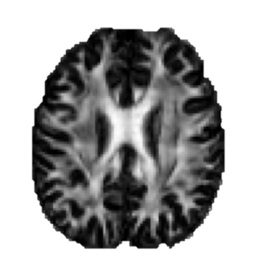
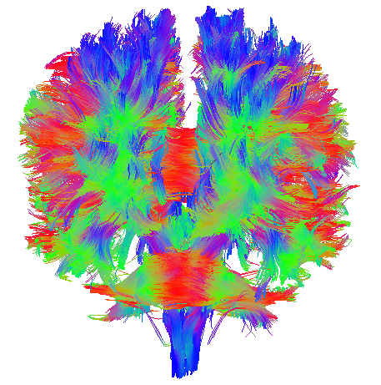
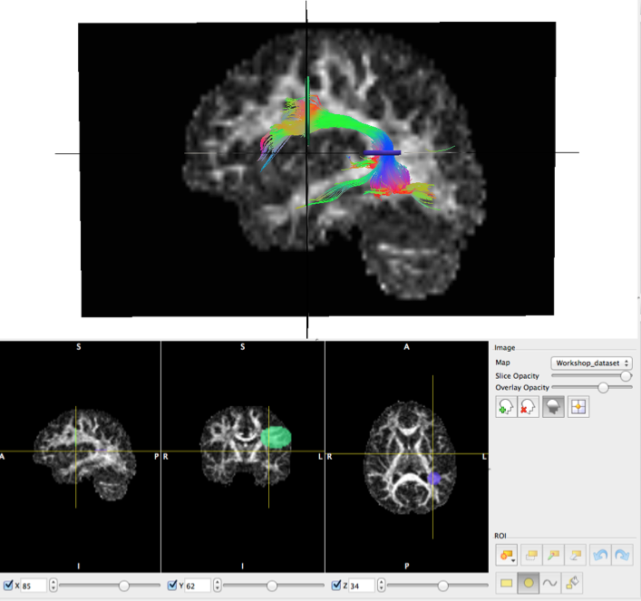
Manual segmentation
Types of ROIs:
Inclusion (logical “and” and “or”)
Exclusion (logical “not”)
How we use ROIs:
Termination Points (e.g. Cortical)
Waypoints (e.g. specific white matter region)
Volumetric (e.g. U-Shape)
Available tools:
Trackvis, Fibernavigator and MI-Brain
Tract-analysis and connectivity - Eleftherios Garyfallidis (2015)

Slide 8
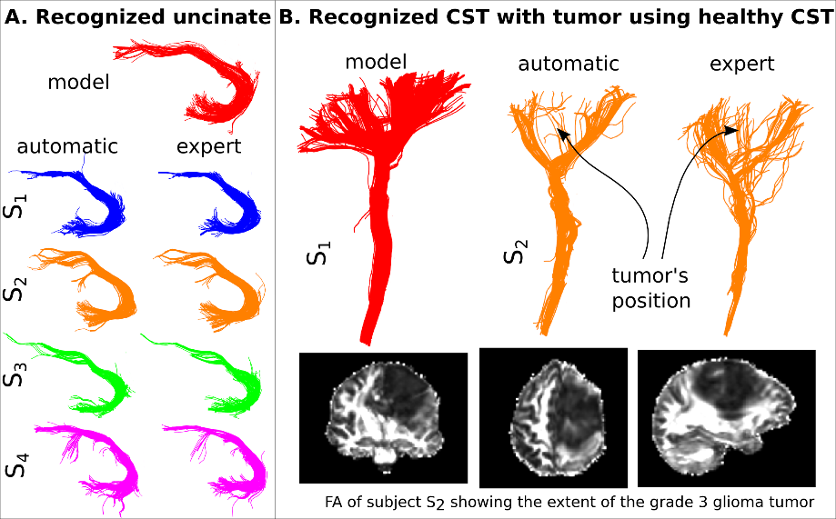
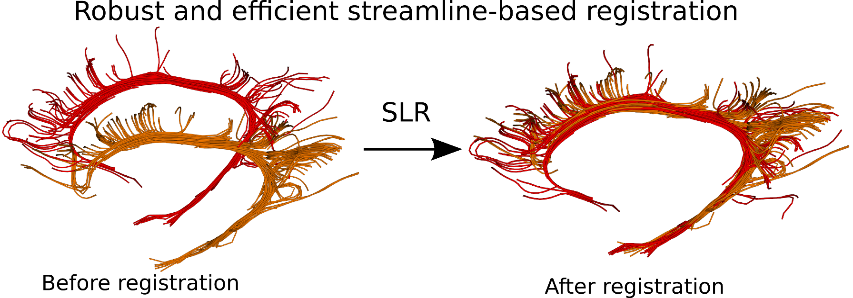

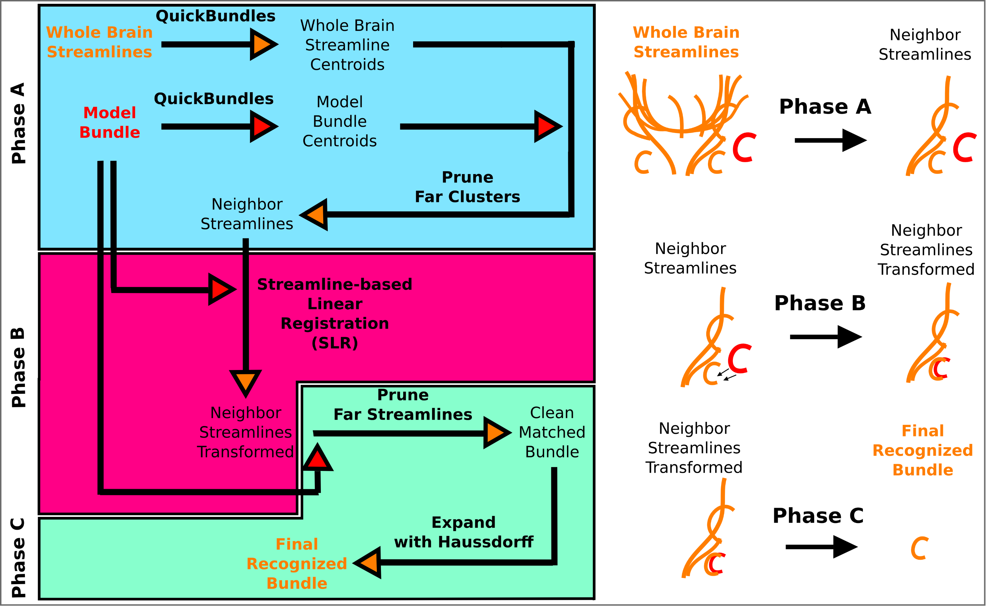
Automatic Segmentation
Tract-analysis and connectivity - Eleftherios Garyfallidis (2015)

Slide 9

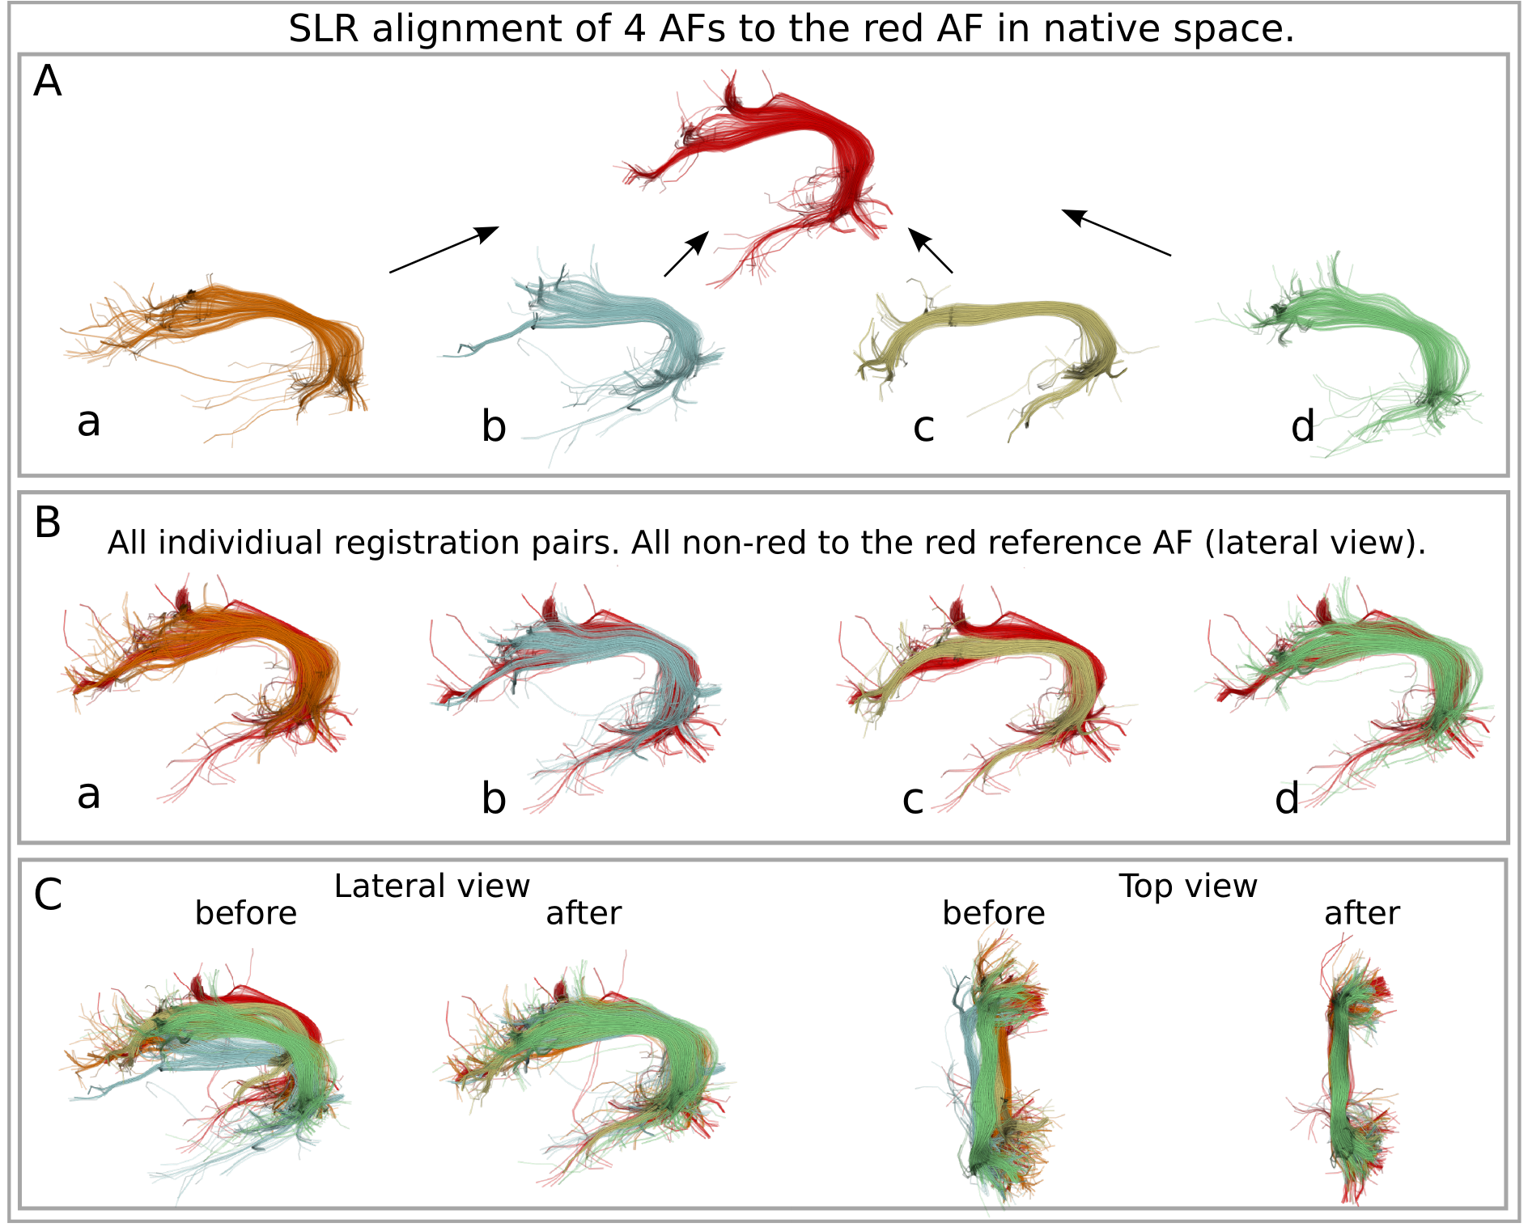
Registration of bundles
Tract-analysis and connectivity - Eleftherios Garyfallidis (2015)

Slide 10
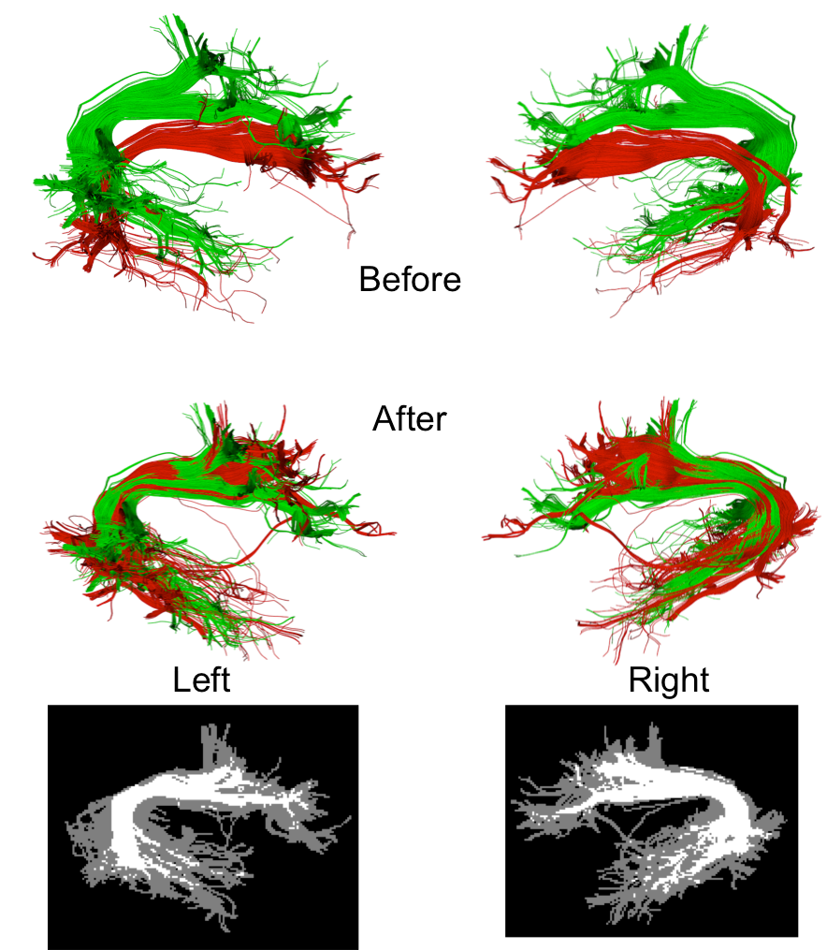
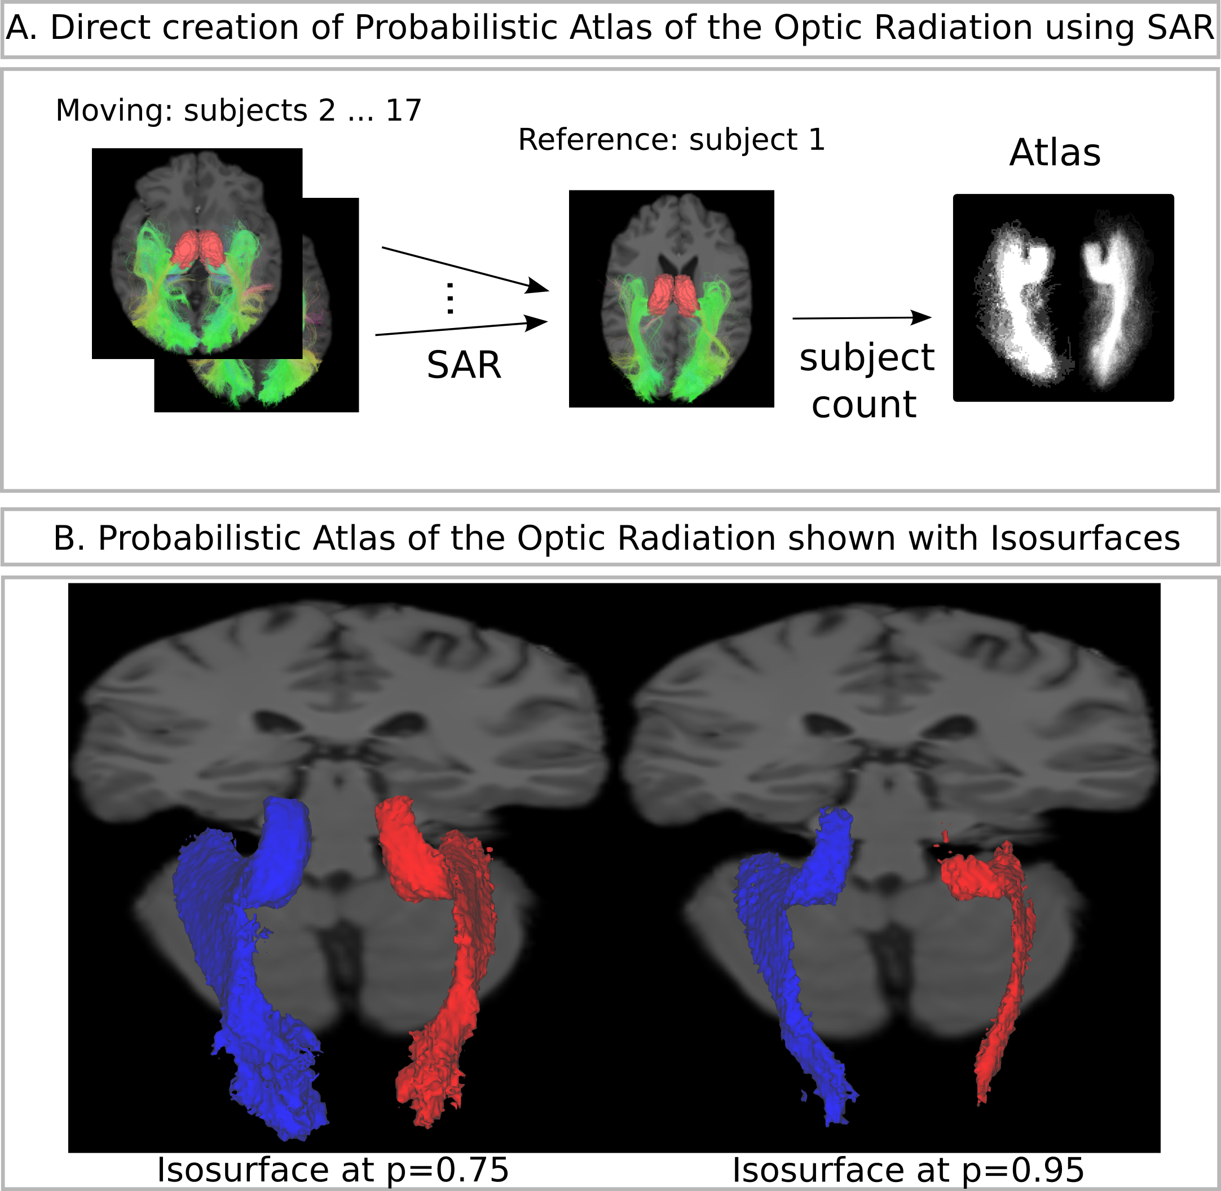
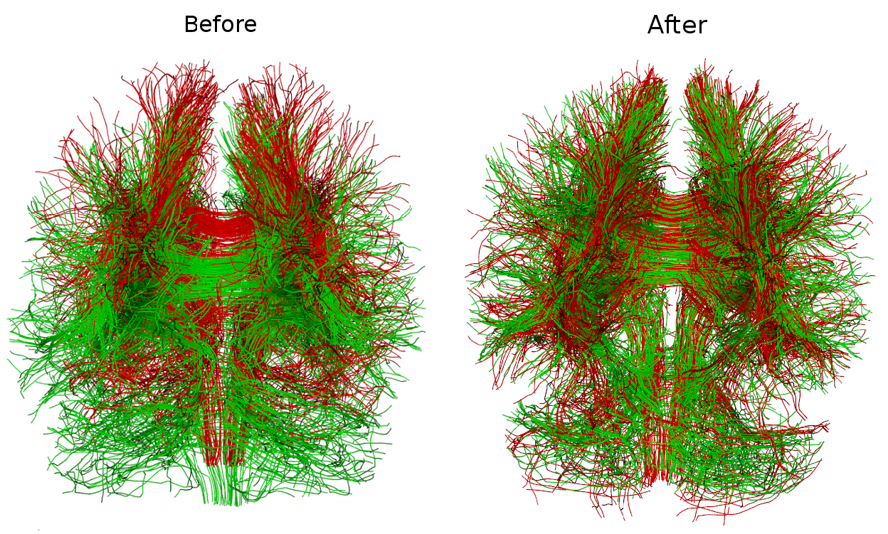
Registration of bundles
Tract-analysis and connectivity - Eleftherios Garyfallidis (2015)

Slide 11
Table of contents for connectivity
Cortical surface
Connect with cortical surface
Connect with sub-cortical areas
Connectivity
Understand the basics of graph theory.
Be critical with counting streamlines.
An example of good counting with the tractometer.
Tract-analysis and connectivity - Eleftherios Garyfallidis (2015)

Slide 12
Table of contents for connectivity
Cortical surface
Connect with cortical surface
Connect with sub-cortical areas
Alerts on how to measure connectivity
Graph theory
Tract-analysis and connectivity - Eleftherios Garyfallidis (2015)

Slide 13
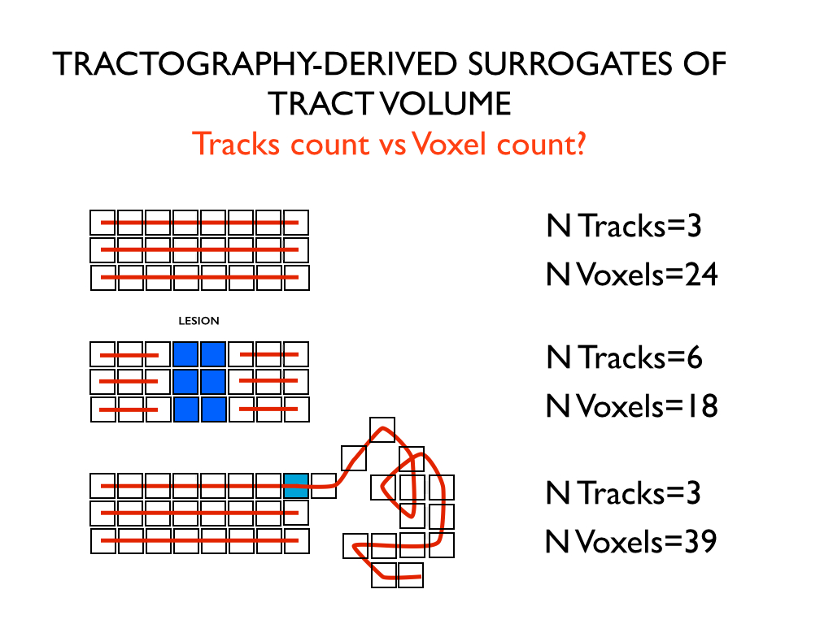
Be critical when counting
Courtesy of Marco Catani
Tract-analysis and connectivity - Eleftherios Garyfallidis (2015)

Slide 14

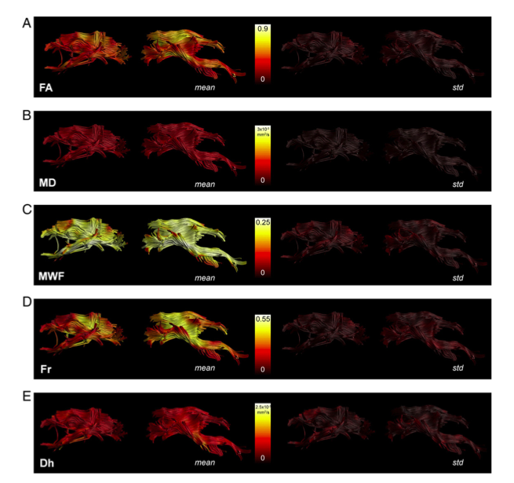
Tractometry
FA₅
FA_{n-1}
FA₄
FA₃
FA₂
FA₁
Bells et al. ISMRM 2012, Assaf et al. Neuroimage 2013,
Catani et al, PNAS 2007, Lebel & Beaulieu HBM 2009, Forkel et al Brain 2014
Tract-analysis and connectivity - Eleftherios Garyfallidis (2015)

Slide 15
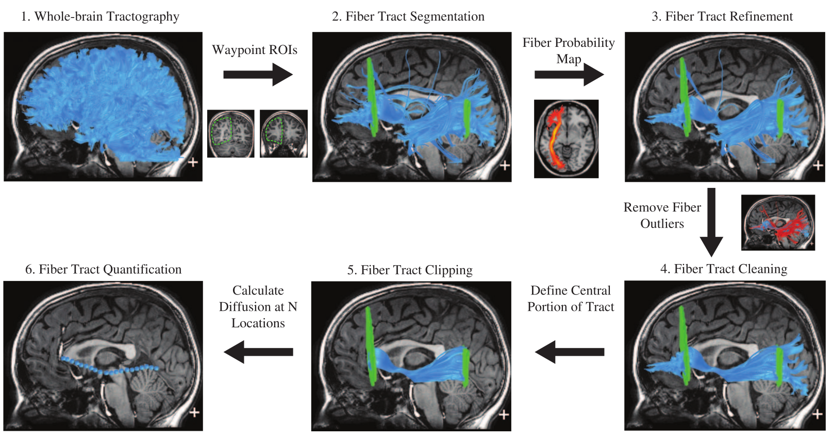
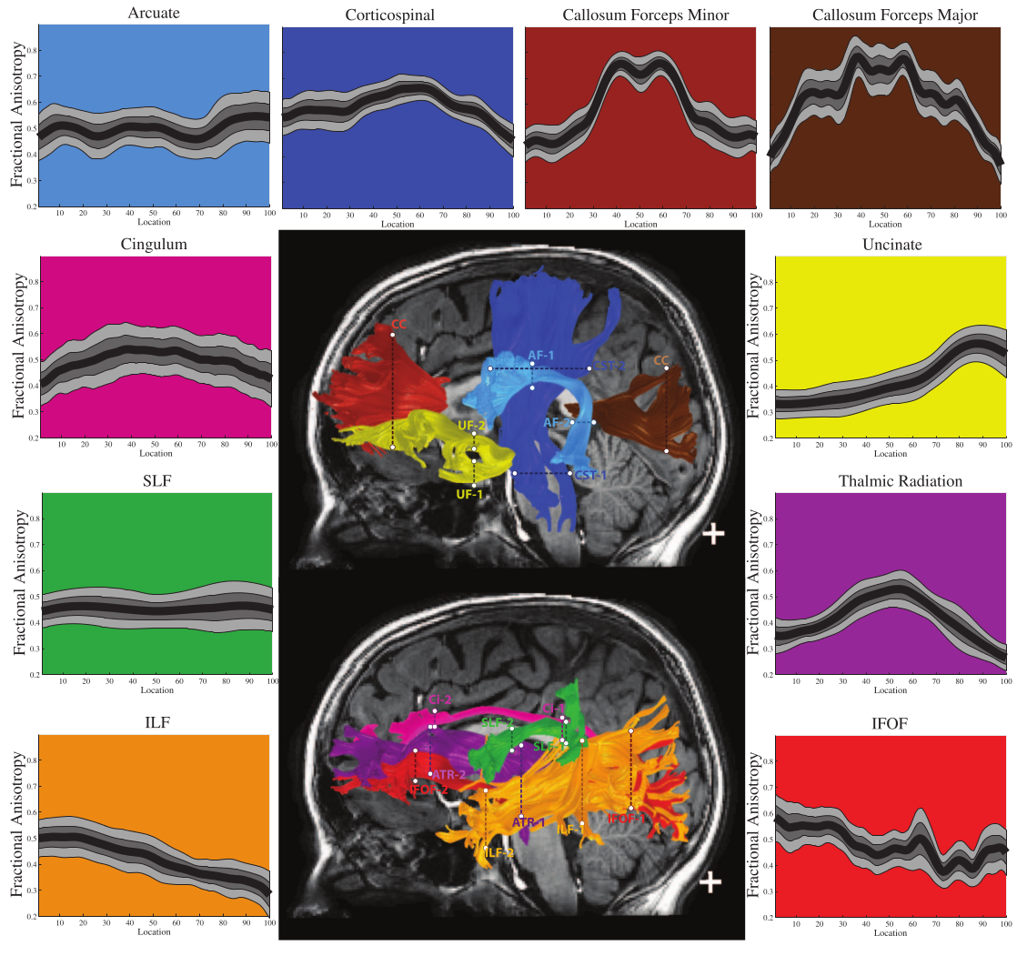
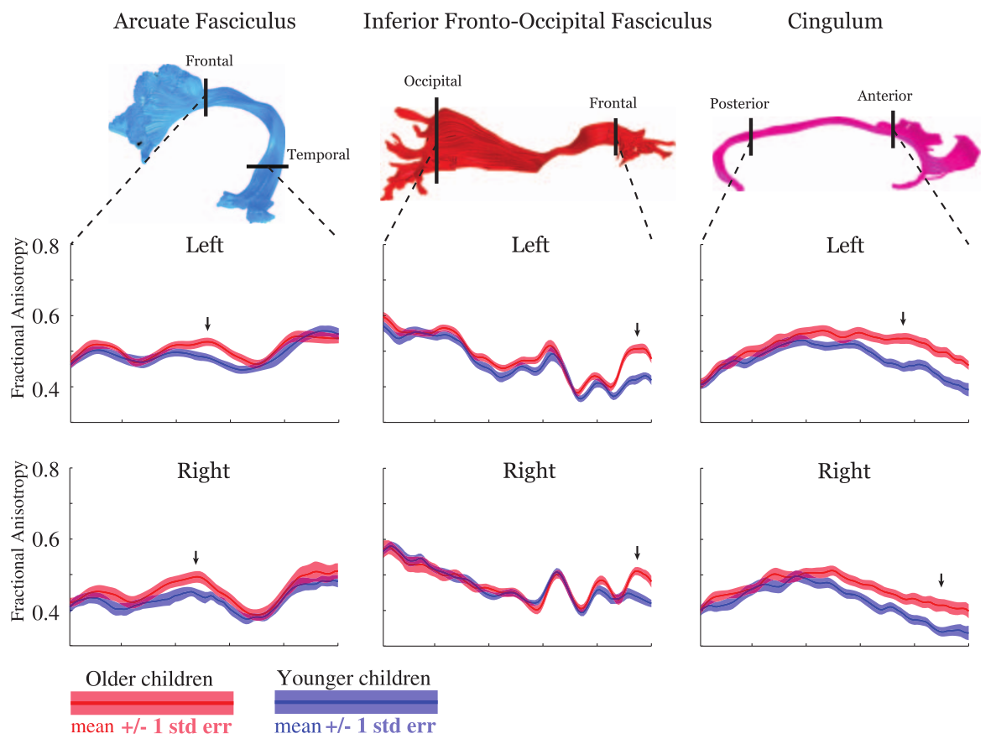
Apparent fiber quantification
Yeatman et al. PLoS 2012
Define planes in MNI space after
registering FA images with
nonlinear registration and project
the planes back in native space.
Tract-analysis and connectivity - Eleftherios Garyfallidis (2015)

Slide 16
Comparing full profiles
Goodlett et al. Neuroimage 2009
Define planes in MNI space after
registering FA images with
nonlinear registration and project
the planes back in native space.
Tract-analysis and connectivity - Eleftherios Garyfallidis (2015)

Slide 17
Topic
Tract-analysis and connectivity - Eleftherios Garyfallidis (2015)

Slide 18
Topic
Tract-analysis and connectivity - Eleftherios Garyfallidis (2015)

Slide 19
Topic
Tract-analysis and connectivity - Eleftherios Garyfallidis (2015)

Slide 20
Topic
Tract-analysis and connectivity - Eleftherios Garyfallidis (2015)

Slide 21
Topic
Tract-analysis and connectivity - Eleftherios Garyfallidis (2015)

